Slide 1

Colour Depiction For Various Sounds (Machine Learning)
Under The Guidance of :
Dr. G. Soma Sekhar (Associate Professor) Presented By:
P. Sharanya (187R1A0541)
A. Keerth Koumudh (187R1A0506)
R. Keerthana yadav (187R1A0536)

Slide 2
CONTENTS
Abstract
Existing System
Disadvantages
Proposed System
Advantages
Hardware and Software requirements
Architecture
Usecase diagram
Data flow diagram
Sample source code
Conclusion

Slide 3
ABSTRACT
The rapidly evolving technologies have been assisting the elderly and people with disabilities through voice assistants to an extent.
There are the people who are in need of assistive devices to perform their day-to day activities for maintaining a healthy, independent, and dignified lifestyle.
But, if voice is the future of everything, then what about the people who can’t hear or speak is the main idea behind the project .
To tackle this problem, a web interface is built which includes a Color Depiction System integrated to a voice assistant. The Color Depiction System would identify and react to various common events
Some common events being opening the door when someone rings the doorbell, attending to a phone call or to respond to a person, etc. The Color Depiction System facilitates to overcome these problems.

Slide 4
EXISTING SYSTEM
There are existing voice assistant systems that can perform few tasks but are not fully functional.
There is a need to increase the ability for the elderly and disabled to communicate by identifying daily life sounds through a system of Colour Depiction using Smart Bulbs and act correspondingly.
Examples of Voice Assistants: Siri, Google Assistant, Amazon Alexa.
Deaf individuals struggle to notice the activities in the surroundings and with minimum obstacles to classify the activities with an assistance.

Slide 5
DISADVANTAGES
The device is more complex.
The deaf can’t be able to watch the device 24*7.

Slide 6
PROPOSED SYSTEM
The Color Depiction System would aid the elderly and disabled community to identify and react to various common events occurring through light emitted from the Smart Bulbs.
When they are lit on activation by surrounding sounds. Some common events being opening the door when someone rings the doorbell, attending a phone call or to respond to a person, etc.
The device can be connected to a hand band of the user (deaf) if the assistive device activated
The hand band of the user will vibrate, then the user will focus on the assistive device and identify the actions happening around the surroundings.

Slide 7
ADVANTAGES
The proposed system is a human assistive application capable of performing Colour Depiction.
This device is mainly developed with an intention of resolving the exhaustive problems of paramount importance related to the elderly and the disabled (deaf and dumb).
This product helps the target audience perform their routine activities.

Slide 8
SYSTEM SPECIFICATIONS
Software Specifications
Platform : Windows 10 or Windows 7
Tool Kit : Tensorflow
Coding Language : Python, Javascript
Back End : Google Colab.

Slide 9
SYSTEM SPECIFICATIONS
HARDWARE REQIREMENTS
Processor : Windows 10 Intel Core
RAM Capacity : 8GB
Components : System in built microphone, Smart Bulb

Slide 10
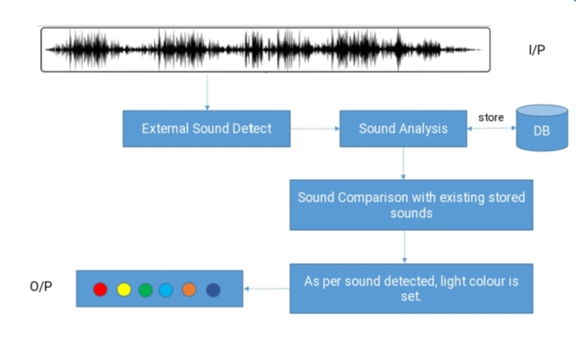
ARCHITECTURE

Slide 11
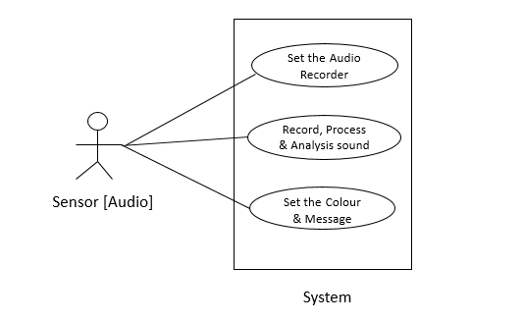
USECASE DIAGRAM

Slide 12
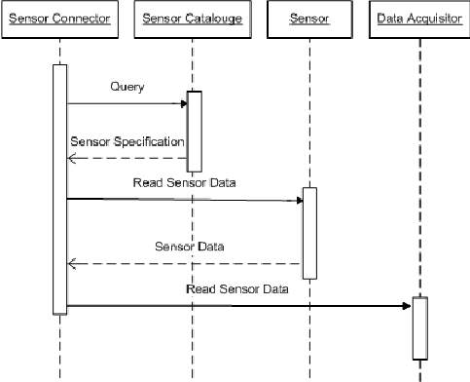
SEQUENCE DIAGRAM

Slide 13
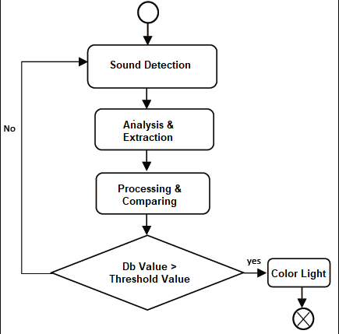
ACTIVITY DIAGRAM

Slide 14
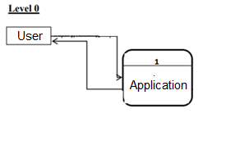
DATA FLOW DIAGRAM
DFD LEVEL-0

Slide 15
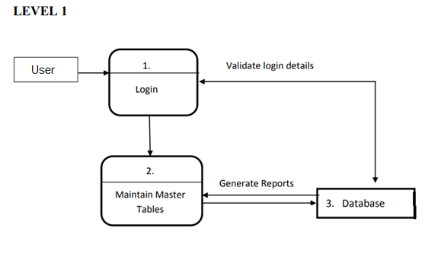
DFD LEVEL-1

Slide 16
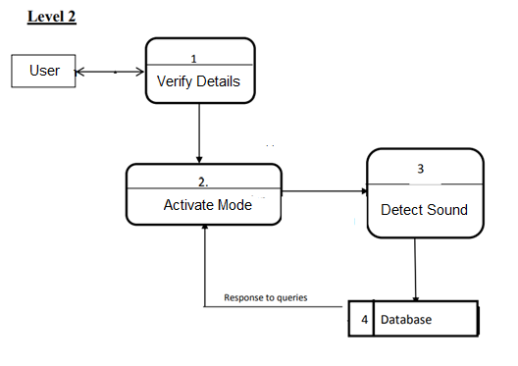
DFD LEVEL-2

Slide 17
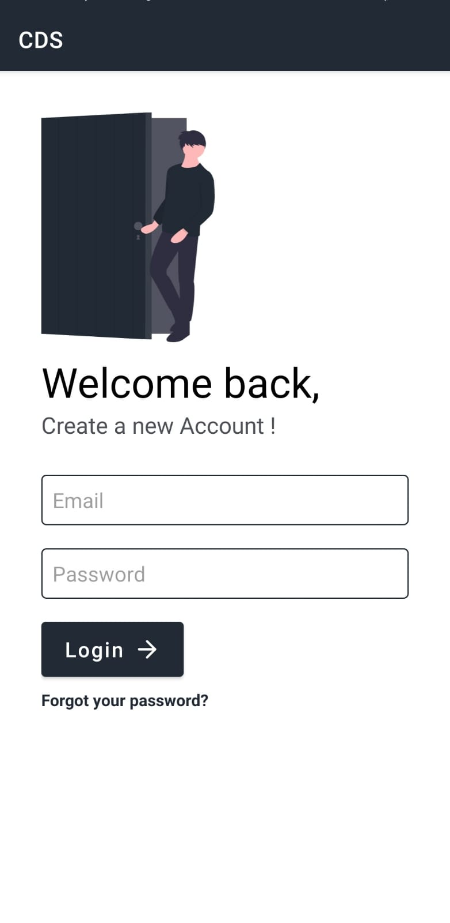
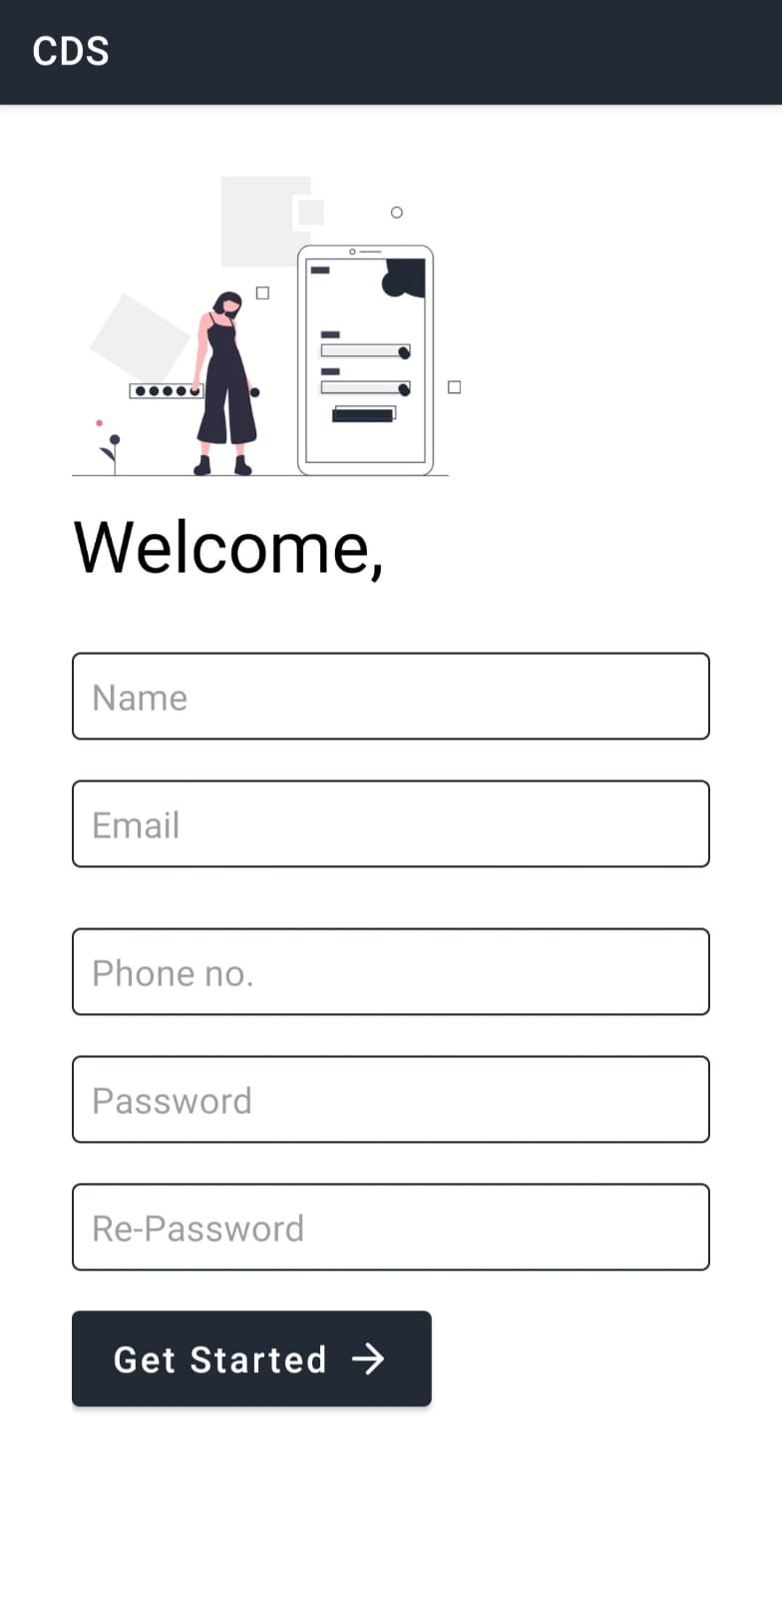
SCREENSHOTS
LOGIN PAGE
SIGN-IN PAGE

Slide 18
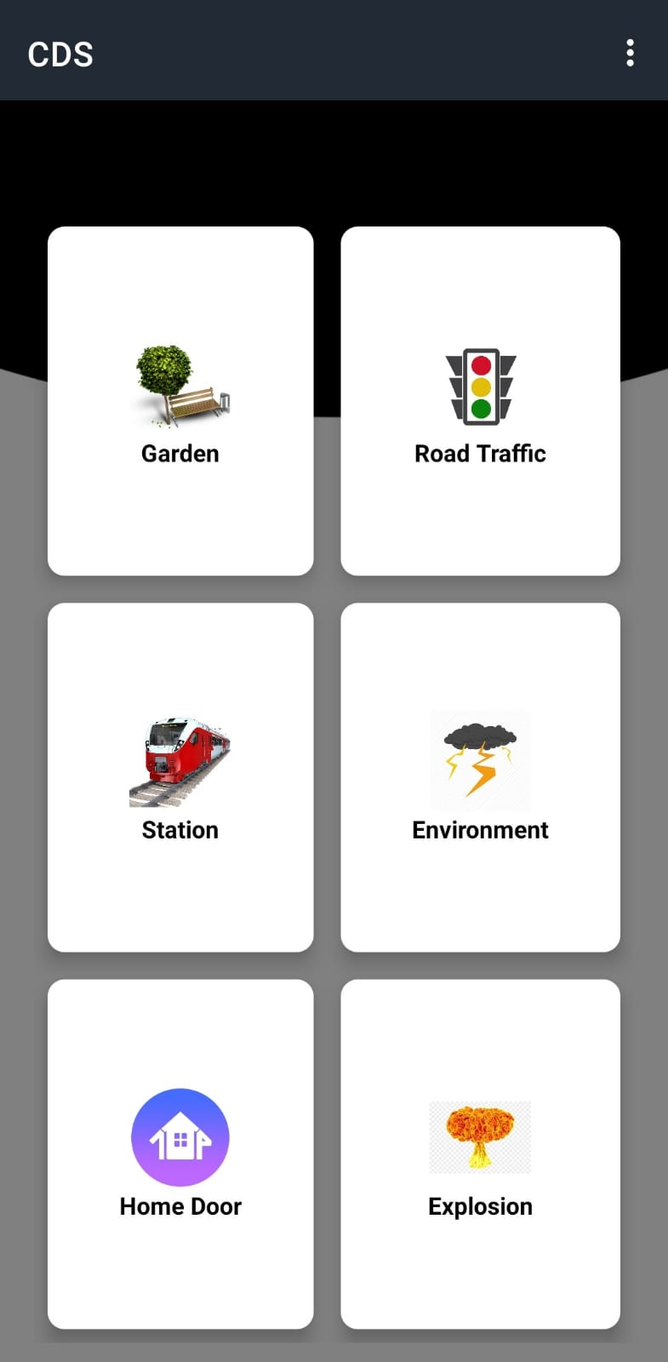
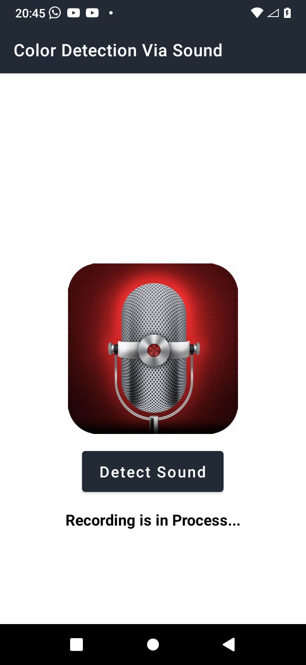
SCREENSHOTS
HOME PAGE
SOUND DETECTION PAGE

Slide 19
SAMPLE SOURCE CODE
public class LoginActivity extends AppCompatActivity {
EditText email, password;
Button login;
TextView register,tvForget;
boolean isEmailValid, isPasswordValid;
TextInputLayout emailError, passError;
private FirebaseAuth firebaseAuth;
ProgressDialog progressDialog;
protected void onCreate(Bundle savedInstanceState) {
super.onCreate(savedInstanceState);
setContentView(R.layout.activity_login);
email = (EditText) findViewById(R.id.email);
password = (EditText) findViewById(R.id.password);
login = (Button) findViewById(R.id.login);
register = (TextView) findViewById(R.id.register);
emailError = (TextInputLayout) findViewById(R.id.emailError);

Slide 20
CODE:
public void SetValidation() {
if (email.getText().toString().isEmpty()) {
emailError.setError(getResources().getString(R.string.email_error));
isEmailValid = false;
} else if (!Patterns.EMAIL_ADDRESS.matcher(email.getText().toString()).matches()) {
emailError.setError(getResources().getString(R.string.error_invalid_email));
isEmailValid = false;
} else {
isEmailValid = true;
emailError.setErrorEnabled(false);
}

Slide 21
CONCLUSION
The goal is to evaluate the use of CNN architecture to classify the sound signals using the spectrograms of the sound spectrum. Convolutional Neural Network is mostly applied to image classification problems.
This shows that these deep neural architectures can be applied to sound classification. This approach using CNN and TDSN(Tensor deep stacking network) for sound classification using spectrograms reduced the number of trainable parameters as compared to direct sound classification.
In the experimental tests, which conducted using CNN, the obtained classification accuracy rate is 91%. From the experiment, this can be evaluated that this approach shows promising results for the development of sound classification system in the critical areas.

Slide 22
Thank You

